Slide 1
HOTEL Review CLASSIFICATION
Team Members :
Mr. Suhash.B
Ms. Thanuja KM
Mr. Yeshwanth R
Mr. Nandyala Sainath Reddy
Mr. Navadinesh K
Mr. Aditya K
Mentor Name : Mr.Karthik

Slide 2
BUSINESS
OBJECTIVE
This is a classification dataset which consists of 20,000 reviews and ratings for different hotels and our goal is to examine how travelers are communicating their positive and negative experiences in online platforms for staying in a specific hotel and major objective is what are the attributes that travelers are considering while selecting a hotel. With this manager can understand which elements of their hotel influence more in forming a positive review or improves hotel brand image.

Slide 3
PROJECT ARCHITECTURE
Collection of Data
Busniess Understanding
Exploratory Data Analysis(EDA)
Deployment
Model Building

Slide 4

DATA SET DETAILS
The data file reviews.csv contains a total of 2 features for 20492 samples. Each row corresponds to a review of a hotel for which it has been collected information about the type of hotel review and rating.

Slide 5
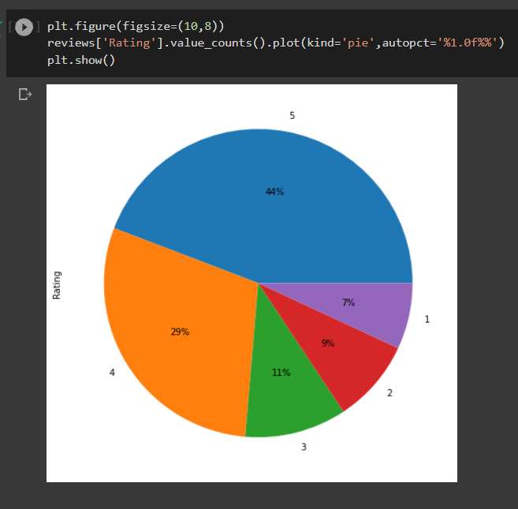
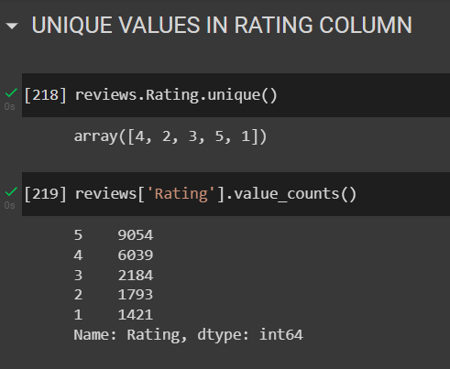
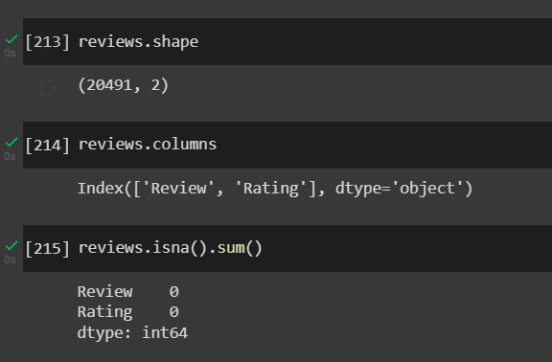
The Data set contains 20491 Rows and 2 Columns

Slide 6
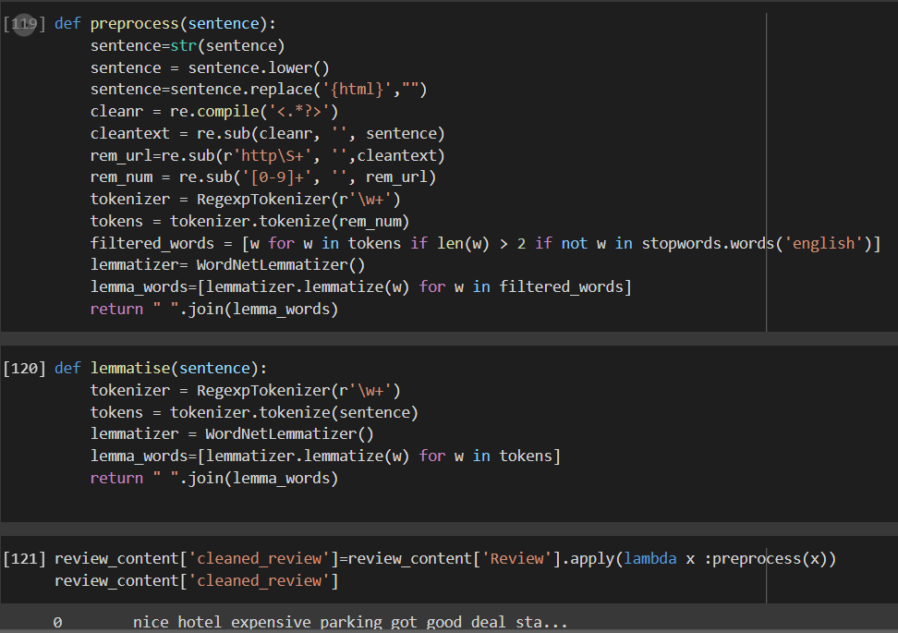
Pre processing the data
Tokenization and Lemmatization to preprocess the data and to get cleaned review

Slide 7
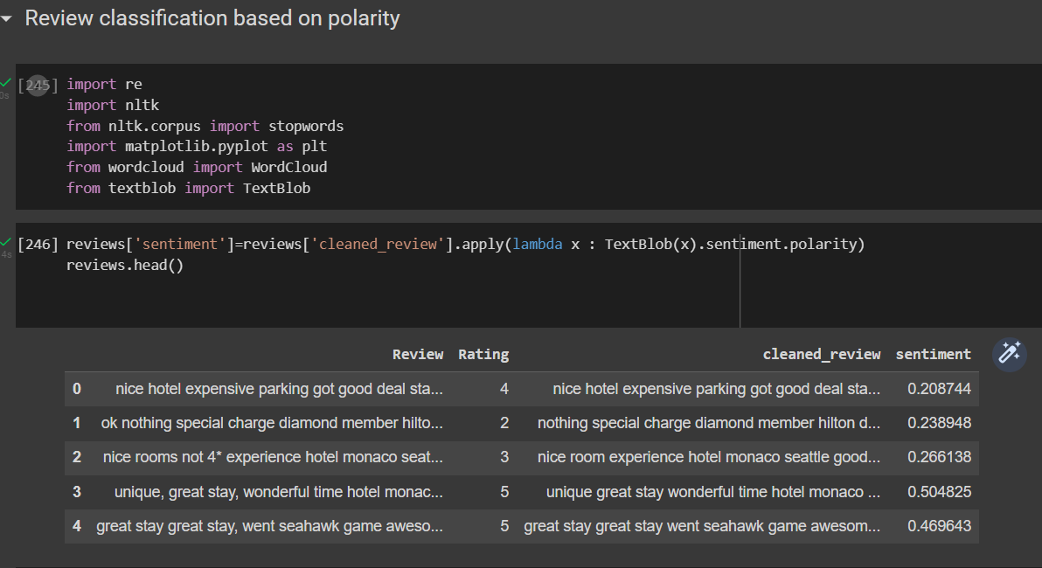
Polarity

Slide 8
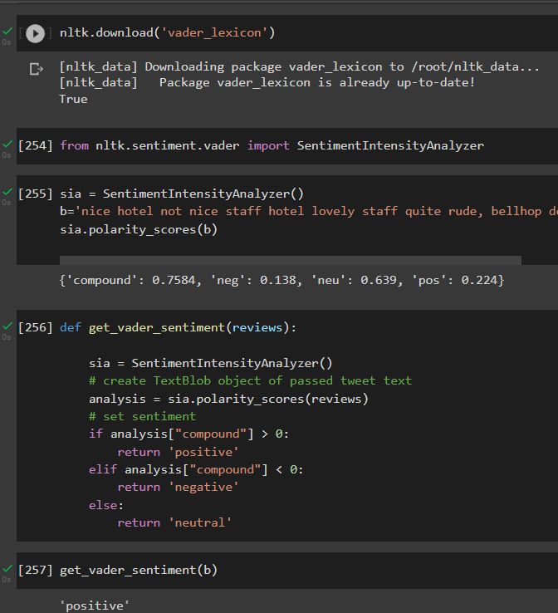
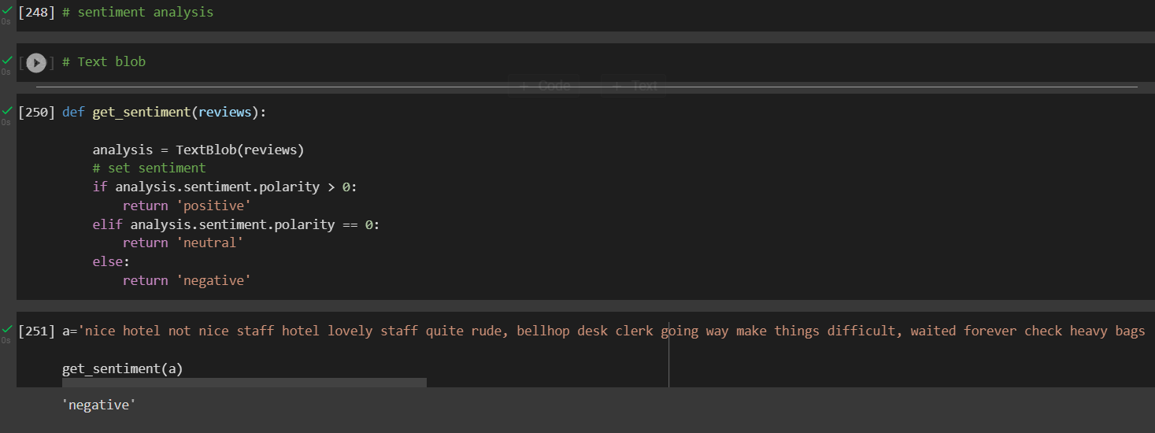
Sentiment analysis
Vander Lexicon
Text Blob

Slide 9
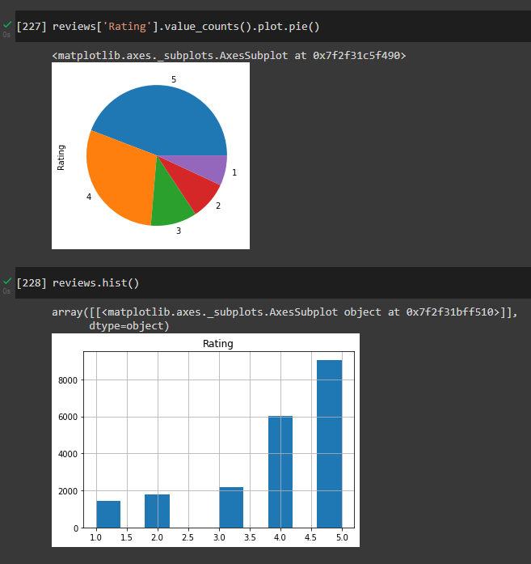
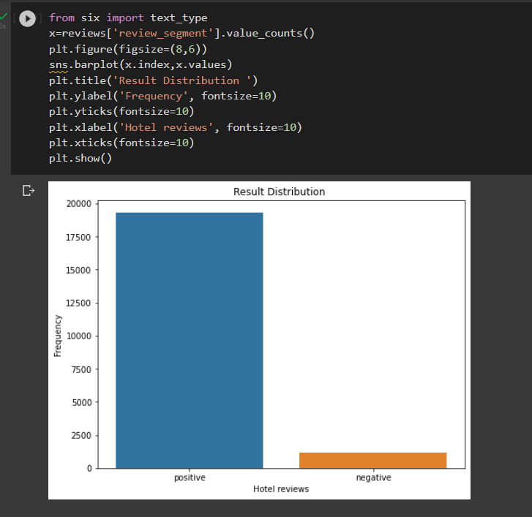
EDA VISUALIZATIONS

Slide 10
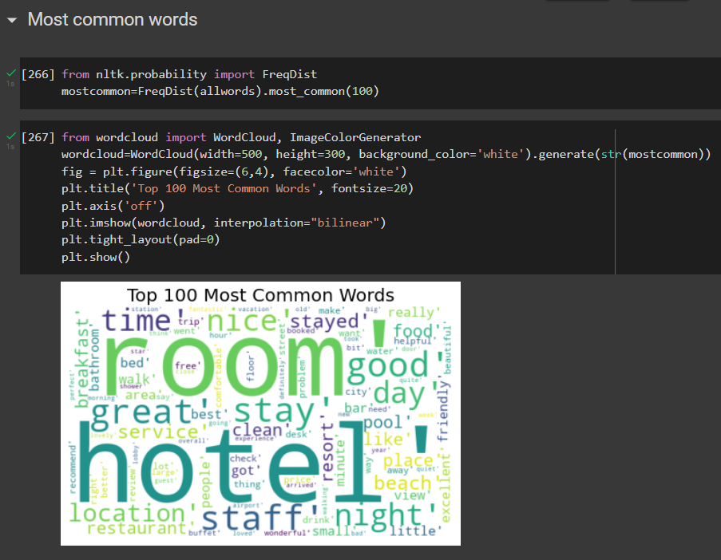
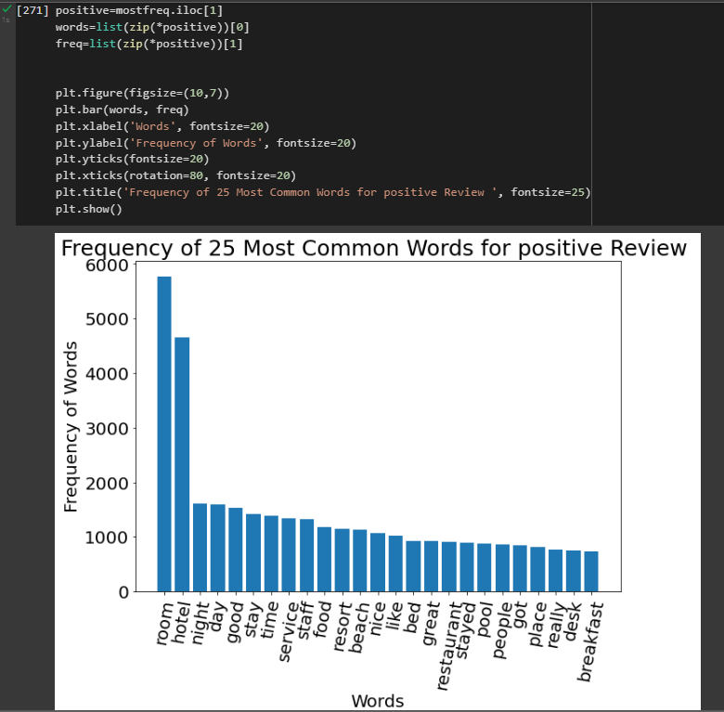
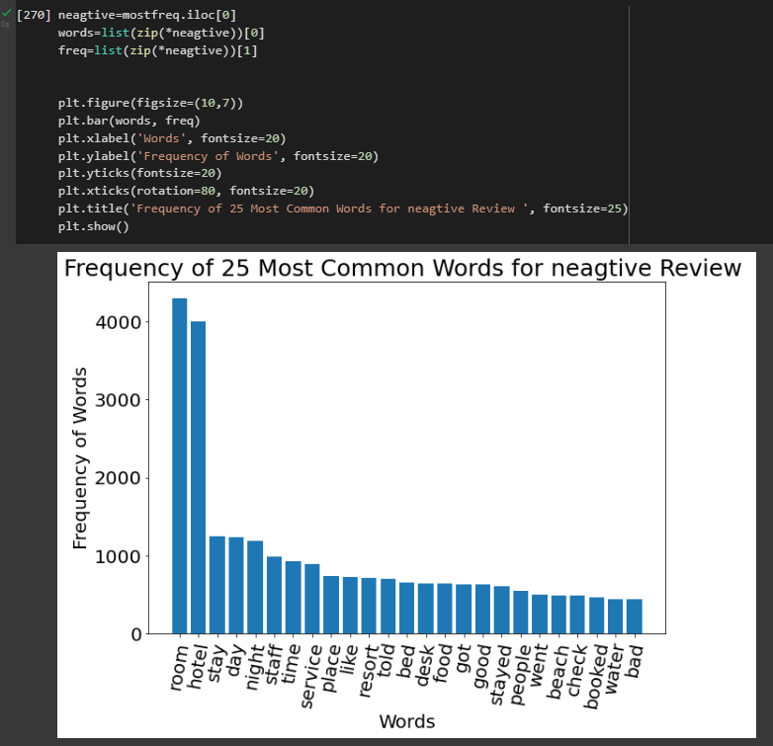
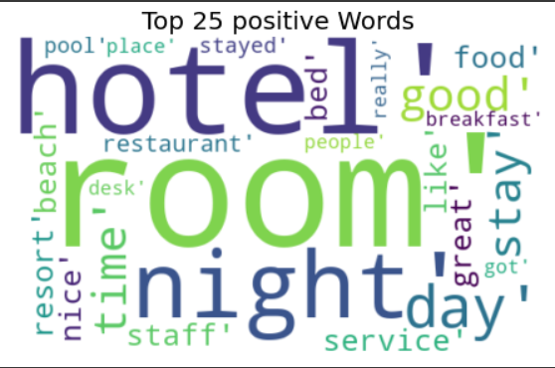
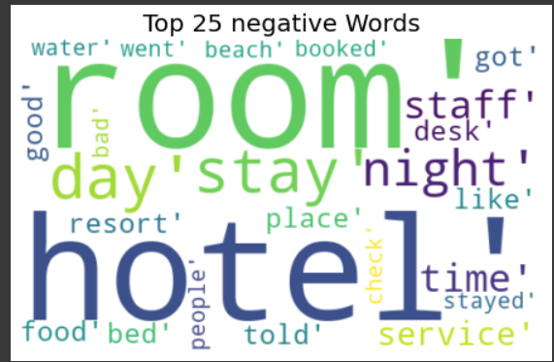
Top 25 negative words
Most common words
Top 25 positive words

Slide 11
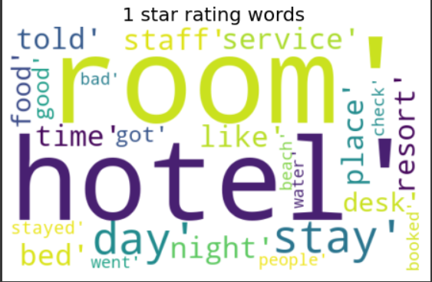
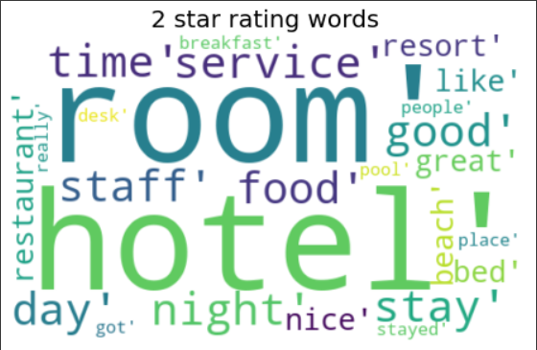
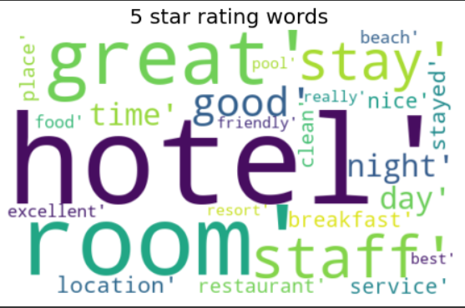
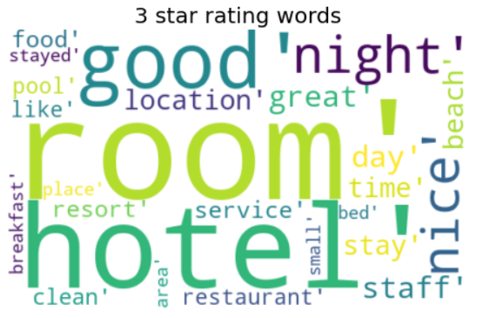
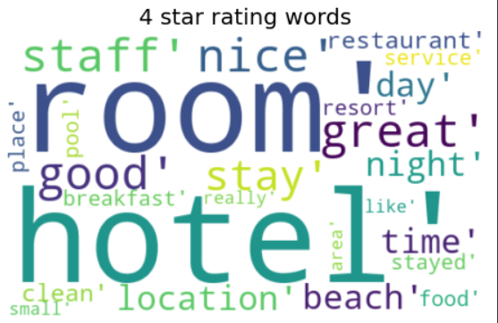

Slide 12
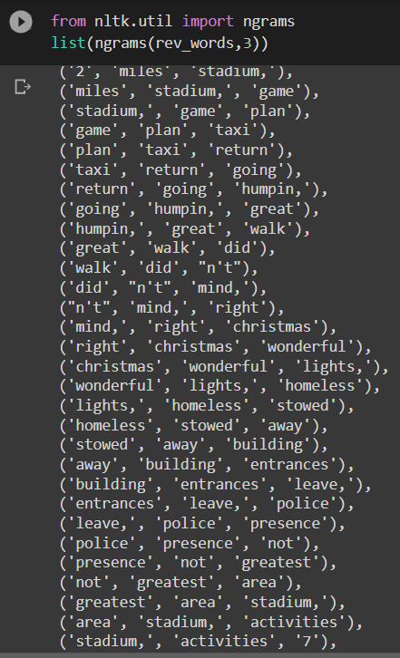
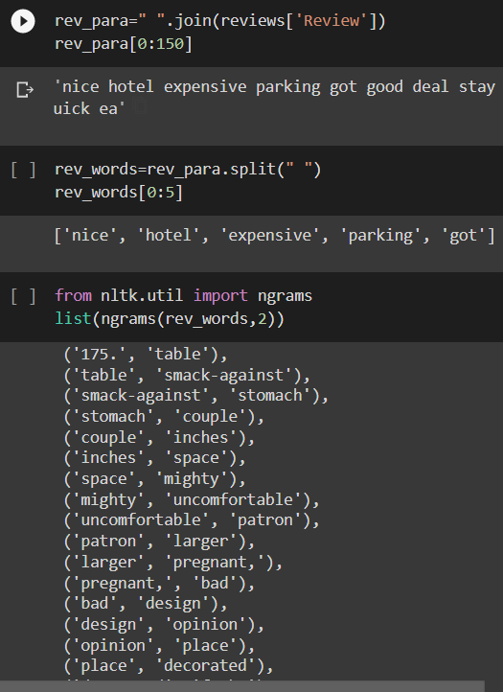
N grams

Slide 13
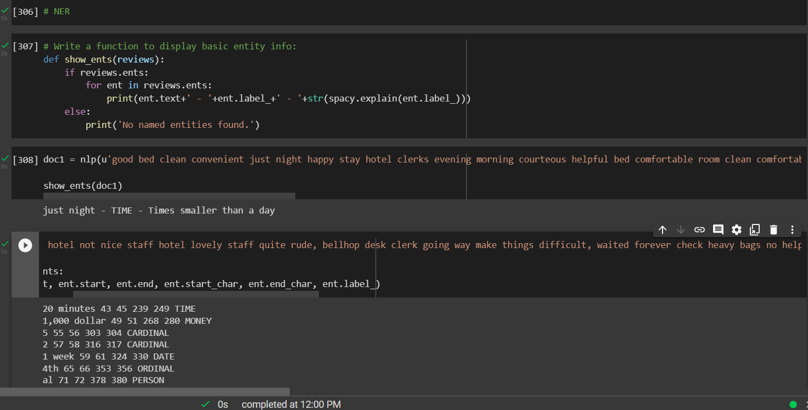
NER Named entity recognition

Slide 14
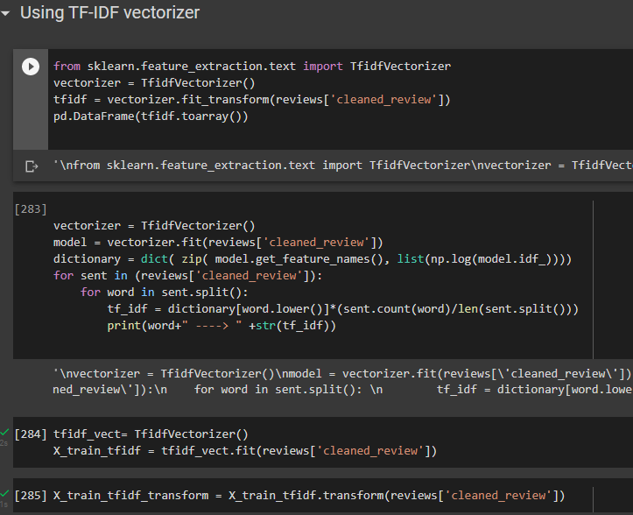
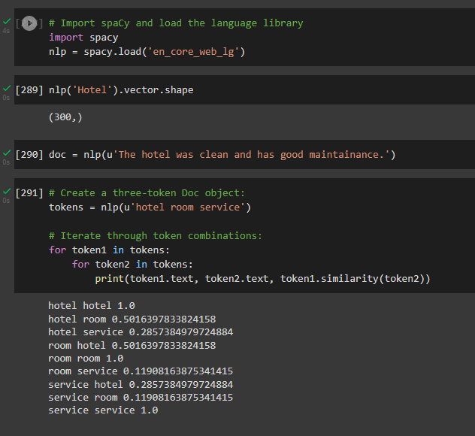
Converting data from text to numeric
TF-IDF vectorizer
Word2Vec

Slide 15
Models Used For Model Building
Logistic Regression
Random Forest
Mutinomial Naive bayes
XGBM Boosting
Gradient Boosting

Slide 16
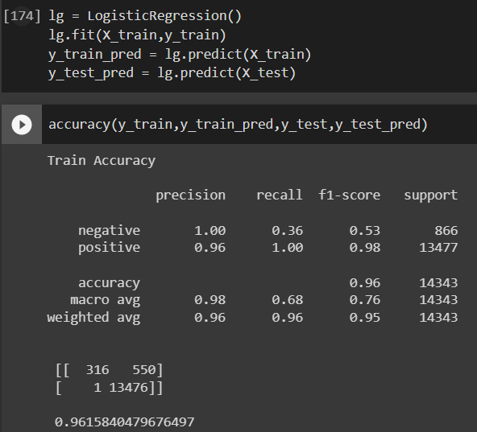
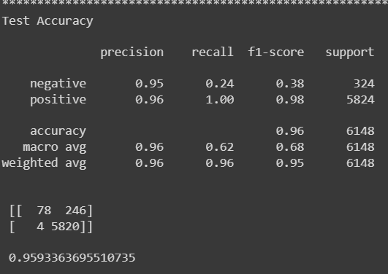
Logistic Regression
For logistic regression accuracy is 96% for training and 95% for the testing data.

Slide 17
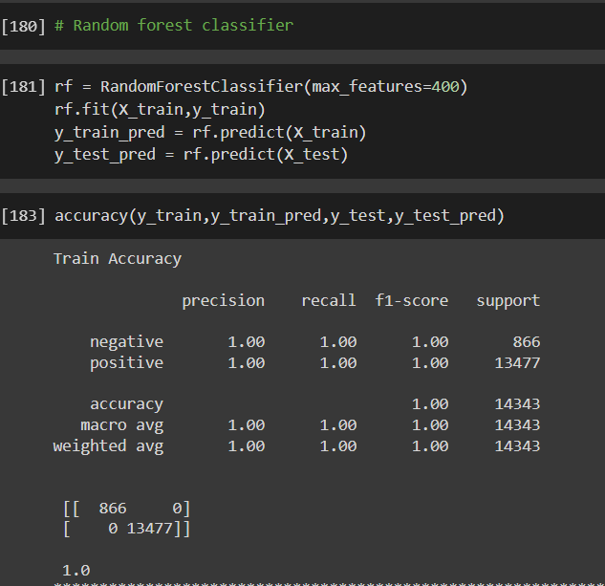
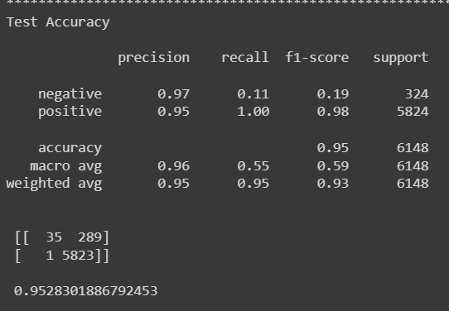
Random Forest Classifier
Accuracy of Random Forest Classifier is 100% for training data and 95% for testing data.

Slide 18
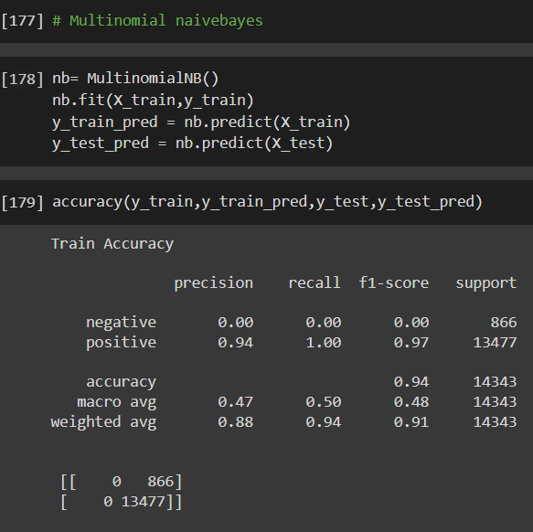
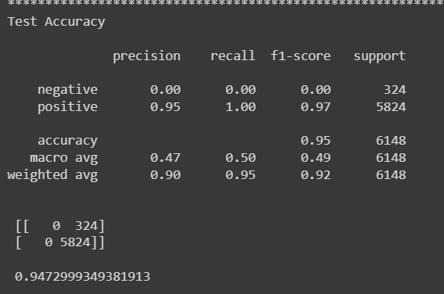
Multinomial Naive Bayes
Accuracy of Multinomial naive bayes is 94% for training data and 94% for testing data.

Slide 19
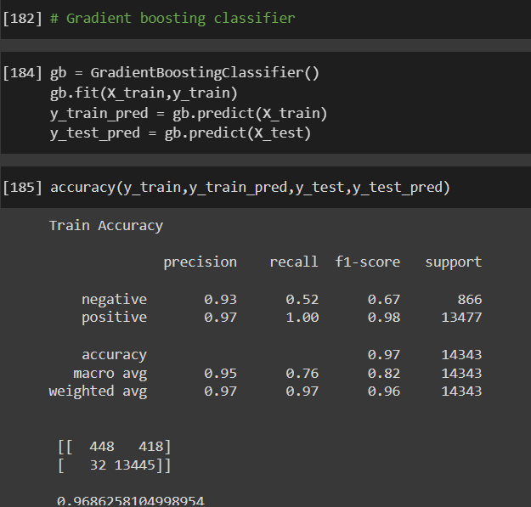
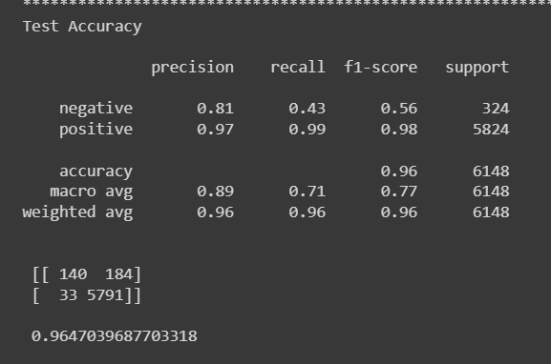
Gradient Boosting
Accuracy of Gradient boosting is 96% for training data and 96% for testing data.

Slide 20
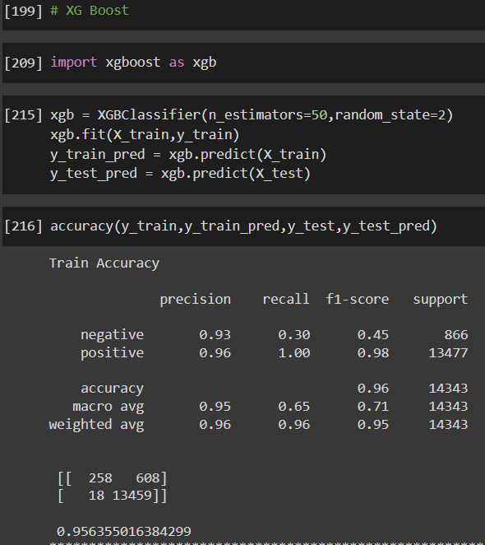
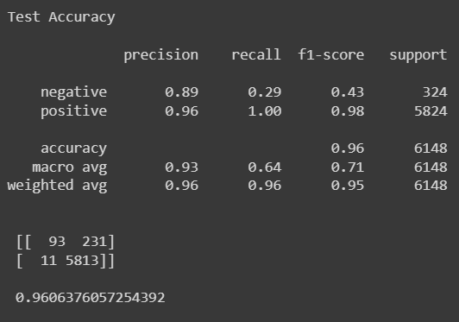
XG Boost Classifier
Accuracy of XG Boost Classifier is 95% for training data and 96% for testing data.

Slide 21
CHallenges Faced
As we apply preprocessing techniques, program run time takes longer
We faced some challenges in deployment part in flask, so we went on with streamlit deployment
The dataset contains 90% of positive reviews and only 10% negative reviews

Slide 22
Deployment using streamlit
Logistic Regression is the best accuracy we got

Slide 23
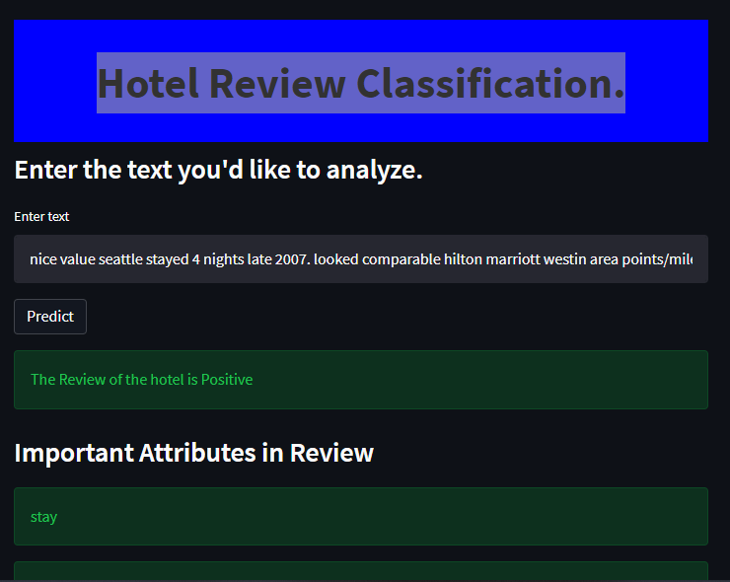

Slide 24
Thank you

